Slide 1



Analysis of Restaurant Reviews and Ratings
Mini project review 3

Slide 2

ACE ENGINEERING COLLEGE
(DEPARTMENT OF DATA SCIENCE)
Under the supervision of Ms. Swathi Turai
Roll Number | Name
22AG5A6702 | P. PRANEETHA
21AG1A6710 | B.RAJASRI AISHWARYA
21AG1A6744 | MOHAMMED ADIL
22AG5A6705 | V.MANI CHARAN

Slide 3


Introduction
Growing Popularity of Food Apps: Widely used for ordering meals and reviewing restaurants, offering valuable feedback.
Challenge for Restaurants: Difficult to gauge whether reviews are positive, negative, or neutral due to unstructured text.
Importance of Sentiment Analysis: Understanding customer feedback helps improve service and customer satisfaction.
Our Solution: Analyzed and classified reviews into three sentiment clusters—positive, negative, and neutral.

Slide 4
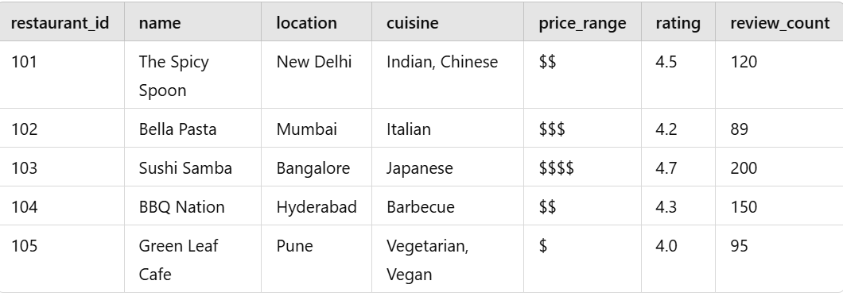
Sample Table: Restaurants
Explanation:
restaurant_id: Unique identifier for each restaurant, name: Name of the restaurant, location: City where the restaurant is located, cuisine: Types of cuisine offered, price_range: Price range indicator ($ - affordable, $$$$ - expensive), rating: Average customer rating, review_count: Number of reviews received.

Slide 5
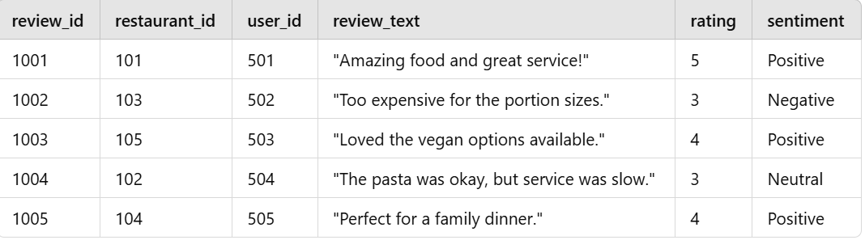
Sample Table: Reviews
Explanation:
review_id: Unique identifier for each review, restaurant_id: Links the review to a specific restaurant, user_id: Identifies the user who wrote the review, review_text: The content of the review, rating: Numerical score given by the user (1-5), sentiment: Predicted sentiment (Positive, Neutral, Negative) derived from the review text.

Slide 6
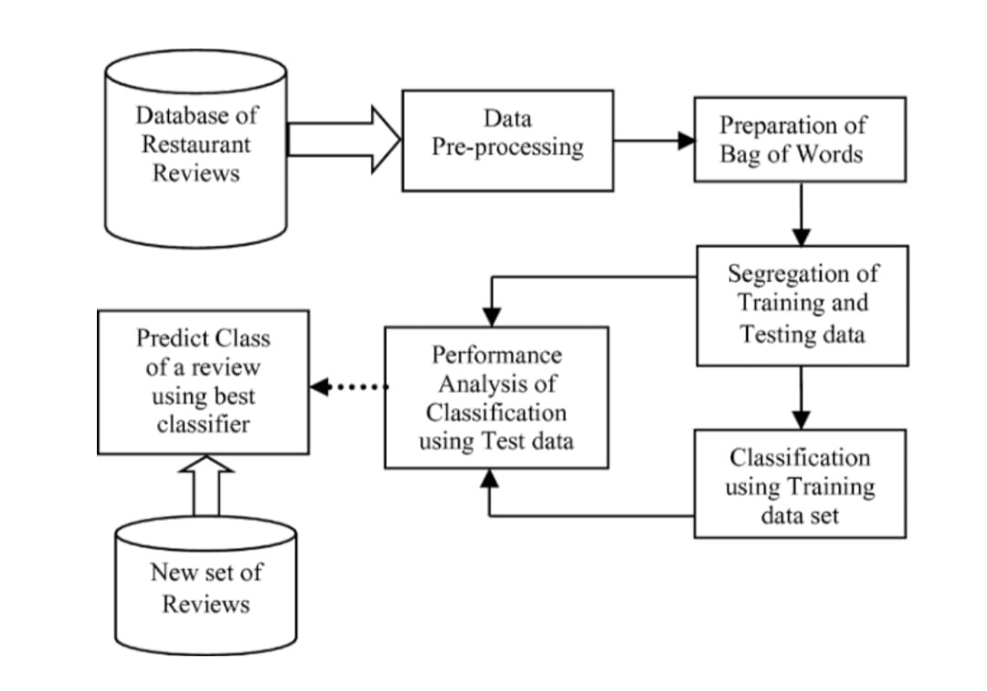

Architecture

Slide 7

Flow chart of Preprocessing
[Data Collection]
↓
[Data Cleaning]
↓
[Text Preprocessing]
↓
[Feature Engineering]
↓
[Encoding Categorical Variables]
↓
[Scaling Numerical Features]
↓
[Data Splitting]

Slide 8
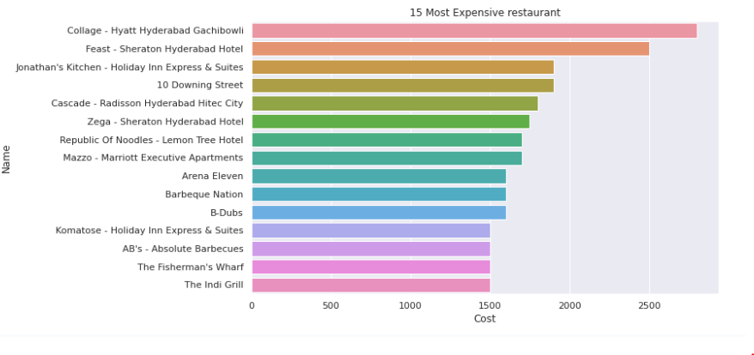
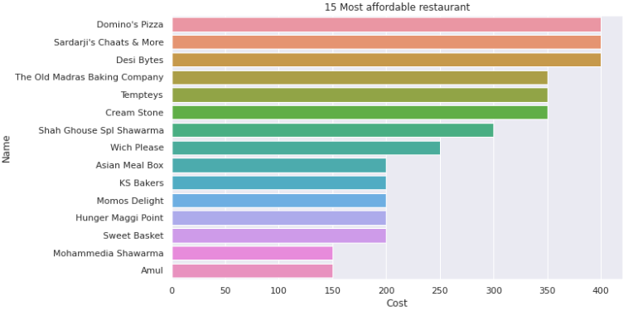
15 Most expensive Restaurants
15 most Affordable Restuarents

Slide 9
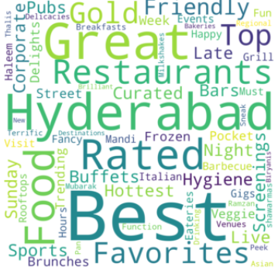
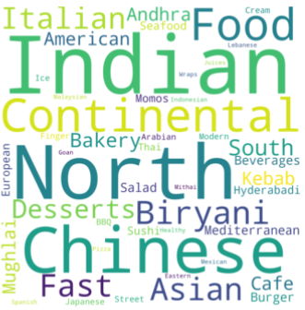
Most used words for Restaurants( Tag )
Frequent Keyword Used for cuisine

Slide 10

Models Used :
K-means Clustering
Hierarchical Clustering
Logistic Regression
Random Forest
XGBoost Modelling
LightGBM
Training Set: 80% of the data used to train the model.
Testing Set: 20% of the data used to evaluate model performance.

Slide 11



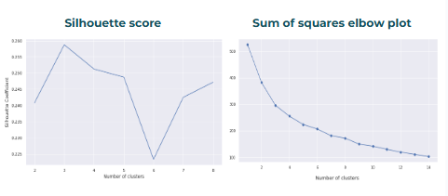
Implementation of Algorithms
K Means Clustering Plots

Slide 12
Implementation of Algorithms
Cuisines in Different Clusters (K-Means)
Cluster 0
North Indian, Chinese, Continental, Mediterranean
European, Seafood, Biryani, Hyderabadi, American
South Indian, Andhra, Kebab, BBQ, Italian
Asian, Mughlai, Beverages, Modern Indian, Desserts
Spanish, Japanese, Salad, Sushi, Mexican
Thai, Malaysian, Indonesian, Goan, Finger Food
Healthy Food
Cluster 1
Ice Cream, Desserts, Cafe, Bakery
Continental, Fast Food, Beverages, Burger
Biryani, North Indian, Mughlai, Juices
Chinese, Mithai, American, Wraps
Cluster 2
North Indian, Continental, American, Chinese
Fast Food, Salad, Burger, Biryani
Mughlai, Asian, Seafood, Momos
Pizza, Hyderabadi, Japanese, Sushi
Finger Food, Kebab, Arabian, South Indian
Street Food, Lebanese, Andhra, Thai, North Eastern

Slide 13
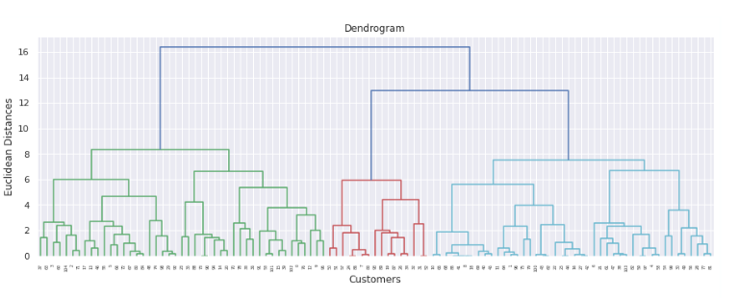
Implementation of Algorithms
Hierarchical Clustering

Slide 14
Implementation of Algorithms
Cuisines in different clusters (Hierarchical)
Cluster 0
'north indian', 'chinese', 'continental', 'mediterranean', 'european', 'seafood', 'biryani', 'hyderabadi', 'american', 'south indian', 'andhra', 'kebab', 'bbq', 'mughlai', 'italian', 'asian', 'beverages', 'modern indian', 'desserts', 'spanish', 'japanese', 'salad', 'sushi', 'mexican', 'bakery', 'juices', 'thai', 'malaysian', 'indonesian', 'goan', 'finger food', 'healthy food'
Cluster 1
I'ice cream', 'desserts', 'cafe', 'bakery', 'continental', 'fast food', 'beverages', 'burger', 'biryani', 'mithai', 'american', 'wraps'
Cluster 2
'north indian', 'continental', 'american', 'chinese', 'fast food', 'salad', 'burger', 'biryani', 'mughlai', 'asian', 'seafood', 'momos', 'pizza', 'hyderabadi', 'japanese', 'sushi', 'finger food', 'kebab', 'arabian', 'south indian', 'street food', 'lebanese', 'italian', 'thai', 'north eastern'

Slide 15
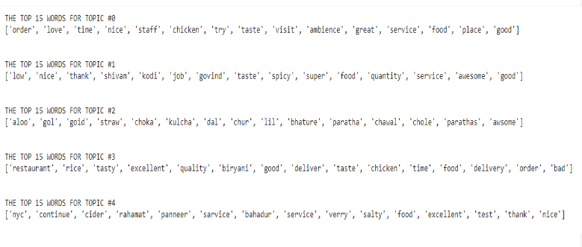
Implementation of Algorithms
LDA top 15 word of each topic

Slide 16
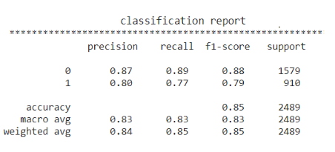
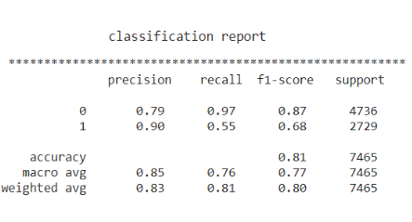
Implementation of Algorithms
Logistic Regression
Random Forest Metrics

Slide 17
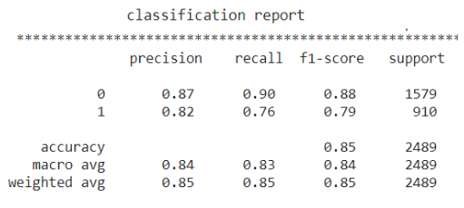
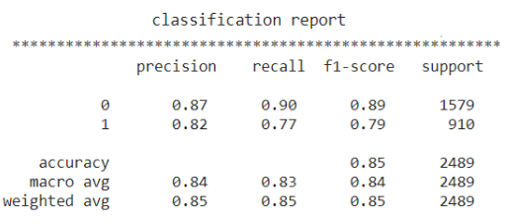
Implementation of Algorithms
XGBoost Modelling
LightGBM

Slide 18
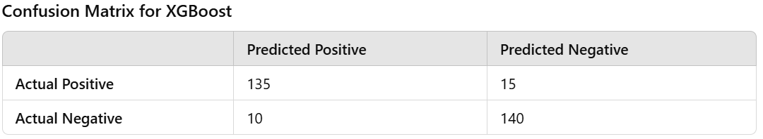
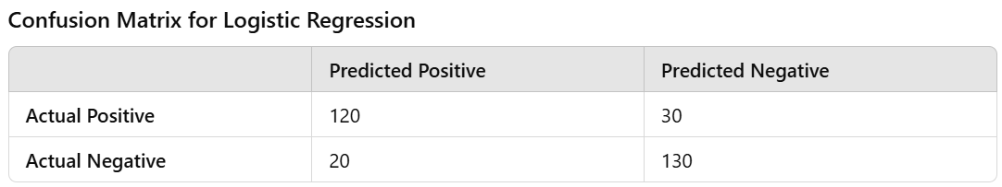

Slide 19
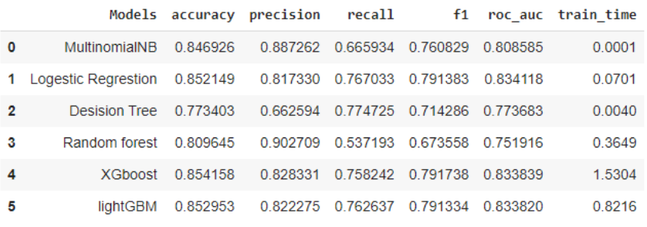
Score Matrix

Slide 20
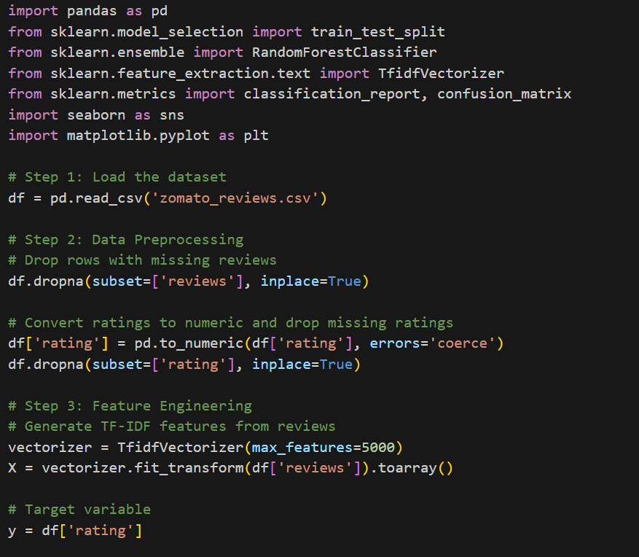

Slide 21
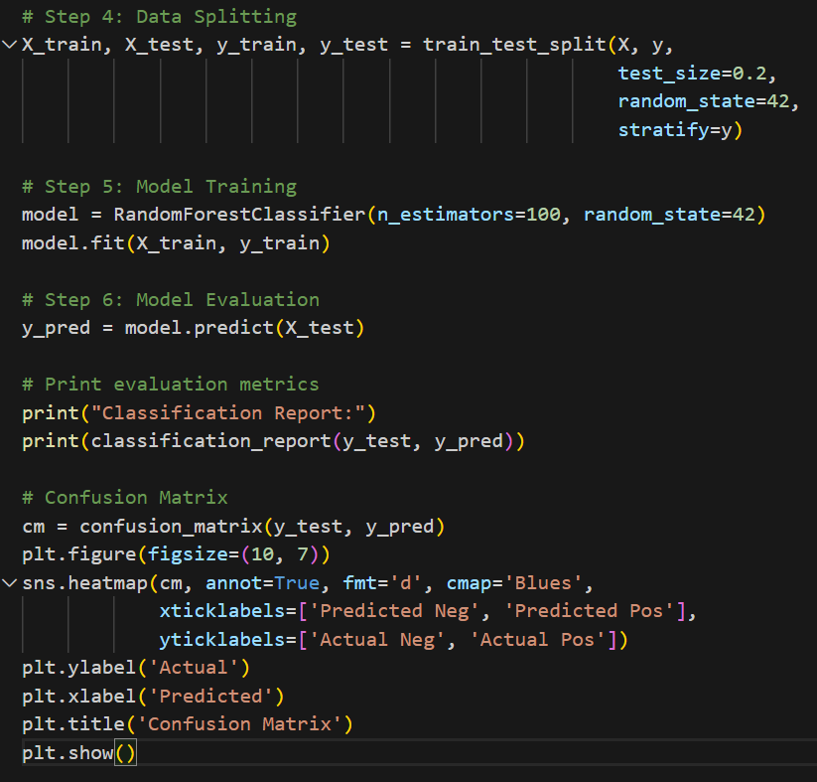

Slide 22

Feature Engineering
Data Cleaning and Preprocessing
Handling Missing Values: Impute missing values with mean/median or use forward fill techniques.
Scaling and Normalization: Standardize numerical features (e.g., ratings, price) to bring them to a similar scale, avoiding skewed clustering due to varying units.
2. Encoding Categorical Data
One-Hot Encoding: Convert categorical features (e.g., cuisine types, restaurant tags) into binary vectors for model compatibility.
Label Encoding: Assign numerical labels for ordinal features where order matters (e.g., rating categories).
3. Feature Selection and Reduction
Dimensionality Reduction with PCA: Identify and retain the principal components that capture most of the variance in data, reducing noise and improving clustering performance.
Keyword Selection for Sentiment Analysis: Identify important words or phrases that impact sentiment, often using methods like chi-square or mutual information.
4. Text-Specific Feature Engineering for Sentiment Analysis
Tokenization and Vectorization: Convert text reviews into numerical vectors (e.g., TF-IDF or Count Vectorizer) for model processing.
Sentiment-specific Features: Identify terms with strong positive/negative sentiment to help classify reviews effectively.

Slide 23
Conclusion
Clustering Analysis: Identified distinct cuisine groups, providing valuable insights for targeted marketing and menu optimization.
Sentiment Analysis: Demonstrated a strong relationship between sentiment scores and customer ratings, revealing key factors influencing satisfaction.
Model Performance: Logistic Regression and XGBoost emerged as the most effective algorithms, delivering high accuracy and robust predictions for rating classifications.
These insights can empower restaurant owners to make informed, data-driven decisions, enhancing customer experience and improving overall operations. Future enhancements could focus on integrating advanced NLP techniques and expanding the dataset for even deeper insights.

Slide 24


Thank You!

